Slide 1


Gujarat University School of Emerging Science and Technology CC-406 Project-II : Project
Topic : Traffic Sign Recognition for Autonomous Vehicles
DS-29 Prem Patel
Enroll no:- 202222600013
Under the guidance of Mr. Rishap Parmar

Slide 2
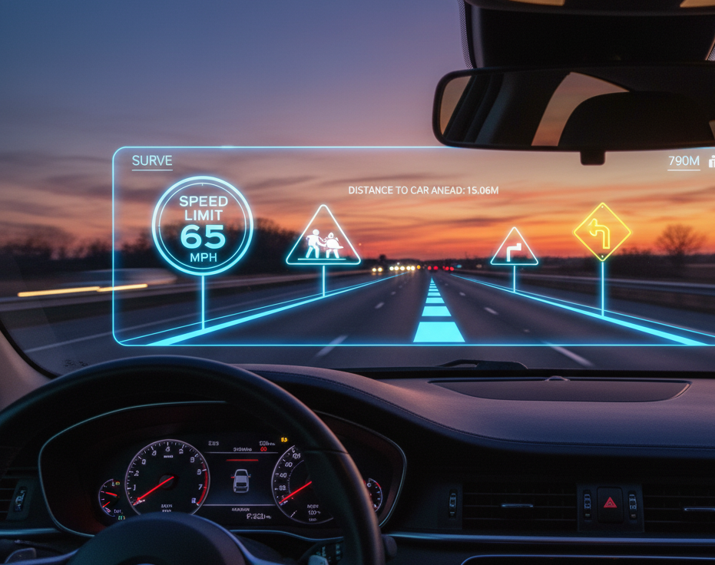
Traffic Sign Recognition for Autonomous Vehicles

Slide 3
Abstract
This project addresses the critical task of Traffic Sign Recognition (TSR) for autonomous vehicles and driver assistance systems by developing a deep learning model based on a Convolutional Neural Network (CNN).
Utilizing the German Traffic Sign Recognition Benchmark (GTSRB) dataset, the methodology incorporates advanced image preprocessing, including Region of Interest (ROI) cropping and Contrast Limited Adaptive Histogram Equalization (CLAHE), along with data augmentation to enhance model robustness.
The resulting model achieves a high accuracy of 98.56% on the unseen test set, demonstrating the effectiveness of CNNs for real-time computer vision tasks essential for driver assistance systems and autonomous driving.

Slide 4
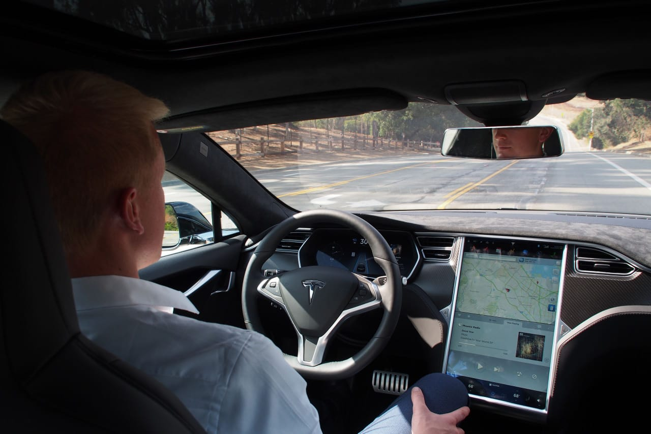
The Autonomous Driving Revolution
Advanced Driver-Assistance Systems (ADAS) and autonomous vehicles are fundamentally transforming how we approach transportation safety and efficiency.
Effective perception of the road environment is absolutely critical for safe autonomous operation. Among all perception tasks, recognizing and interpreting traffic signs stands as one of the most critical skills for ensuring approval with traffic laws.

Slide 5
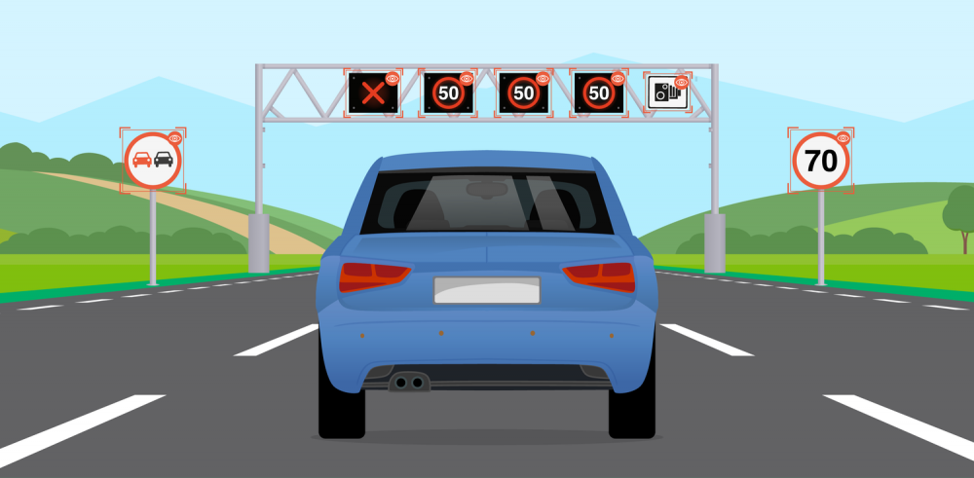
What is Traffic Sign Recognition (TSR)?
Definition: A technology that enables a vehicle to recognize traffic signs on the road.
Two Core Steps:
Detection: Locating the sign within an image.
Classification: Identifying the specific type of sign (e.g., 'Stop', 'Speed Limit 50km/h’).
Application: The vehicle's control system uses this data to make critical driving decisions.

Slide 6
Technical Challenges in TSR
Environmental Variability : Lighting (day/night), weather (rain/fog), and sign condition (faded/vandalized).
Geometric Distortions : Viewing signs from different angles, distances, or when they are partially blocked.
Image Quality Issues : Motion blur from moving vehicles and camera limitations affect image clarity.
Class Imbalance : Some traffic signs appear far more frequently than others, potentially biasing model performance.

Slide 7
Primary Objectives
Design and Train a CNN: To build and train a highly accurate Convolutional Neural Network (CNN) model capable of classifying 43 different types of German traffic signs from image data provided by the GTSRB dataset.
Achieve High Accuracy: To achieve a high classification accuracy on the test dataset, ensuring the model is reliable and robust enough for practical test.

Slide 8
Implement Advanced Preprocessing: To implement and evaluate effective image preprocessing techniques, including ROI cropping and CLAHE, to improve the model's performance under varied real-world conditions like poor lighting.
Develop a Functional Prototype: To build a functional application, such as a GUI for image uploads or a real-time webcam feed, to demonstrate the model's practical application in a simulated environment.

Slide 9
Literature review
Girish Kumar N. G, Ashish Kishore, and Aaditya J. Krishna (2025) developed a real-time Traffic Sign Recognition system using CNNs, achieving 99.63% accuracy on GTSRB and 99.68% on CTSD. Integrating preprocessing, sensor fusion, and vehicle control, it enables accurate detection, speed regulation, and obstacle avoidance. With 24–30ms latency, the system ensures reliable, scalable, and cost-effective performance for autonomous vehicles.

Slide 10
Wael Farag and Zakaria Saleh (2025) developed a deep CNN-based classifier, “WAF-LeNet,” for traffic sign recognition in autonomous driving systems. The 15-layer network, trained using the German Traffic Sign Dataset and optimized with Adam’s algorithm, achieved 96.5% accuracy on the test set and 100% on additional web-sourced images. Their approach demonstrated strong robustness and reliability, supporting real-time traffic sign identification in diverse conditions.

Slide 11
Danyah A. Alghmgham, Ghazanfar Latif, Jaafar Alghazo, and Loay Alzubaidi (2018) developed a real-time Autonomous Traffic and Road Sign (ATRS) recognition system using a Deep Convolutional Neural Network (CNN). Their work introduced the SA-TRS-2018 dataset, comprising 2718 images of 24 traffic sign classes collected across various conditions in Saudi Arabia. The CNN model achieved 100% accuracy, outperforming previous studies and demonstrating strong potential for driver assistance and autonomous vehicle applications.

Slide 12
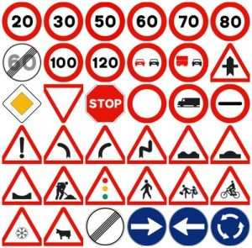
Dataset
German Traffic Sign Recognition Benchmark (GTSRB)
Comprehensive dataset containing over 50,000 images across 43 distinct traffic sign classes, providing robust training data for model development.

Slide 13
Preprocessing Pipeline
ROI Cropping: Isolate the sign from its background to focus the model's attention.
CLAHE Enhancement: Apply Contrast Limited Adaptive Histogram Equalization to improve image contrast and detail.
Data Augmentation: Artificially expand the dataset through rotation, zooming, and shifting to build a more robust model.

Slide 14
Model Architecture :
Convolutional Neural Network (CNN)
A deep learning model specifically designed for image classification tasks.
1.
2.
3.
Convolutional Blocks
Two blocks with Conv2D layers, Batch Normalization, and Max Pooling to extract features.
Dropout Layers
To prevent overfitting and improve generalization.
Classification Head
A Flatten layer followed by Dense layers to make the final prediction with a Softmax activation.

Slide 15
Outstanding Performance Results
98.56%
Test Set Accuracy
Training Analysis Insights
Our model achieved outstanding results,, surpassing the 90% accuracy and demonstrating remarkable reliability on unseen data.
Accuracy and loss curves reveal stable learning progression with excellent generalization from training to validation sets, indicating robust model architecture and effective regularization.

Slide 16
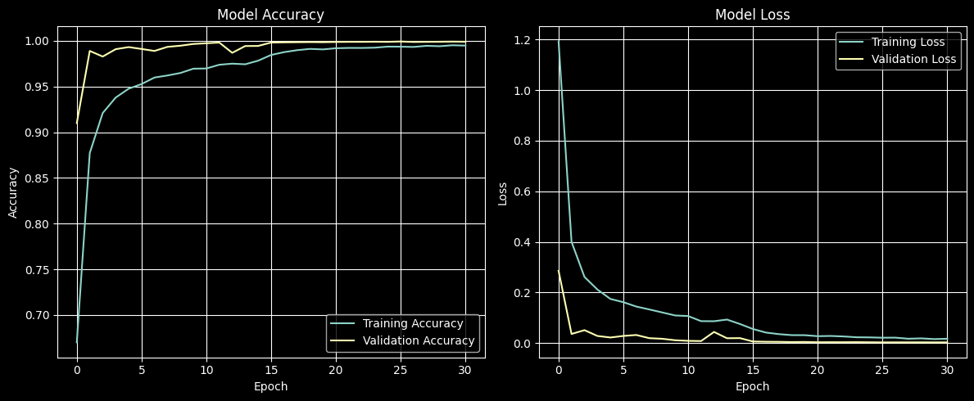

Slide 17



Live Demonstration & Prototype
A functional GUI was developed to test the model on images.
Image Upload
Upload traffic sign image for instant analysis and classification.
Instant Prediction
Receive an immediate prediction of the sign type with high accuracy.
Confidence Score
View the model's confidence score for each prediction to assess reliability.

Slide 18
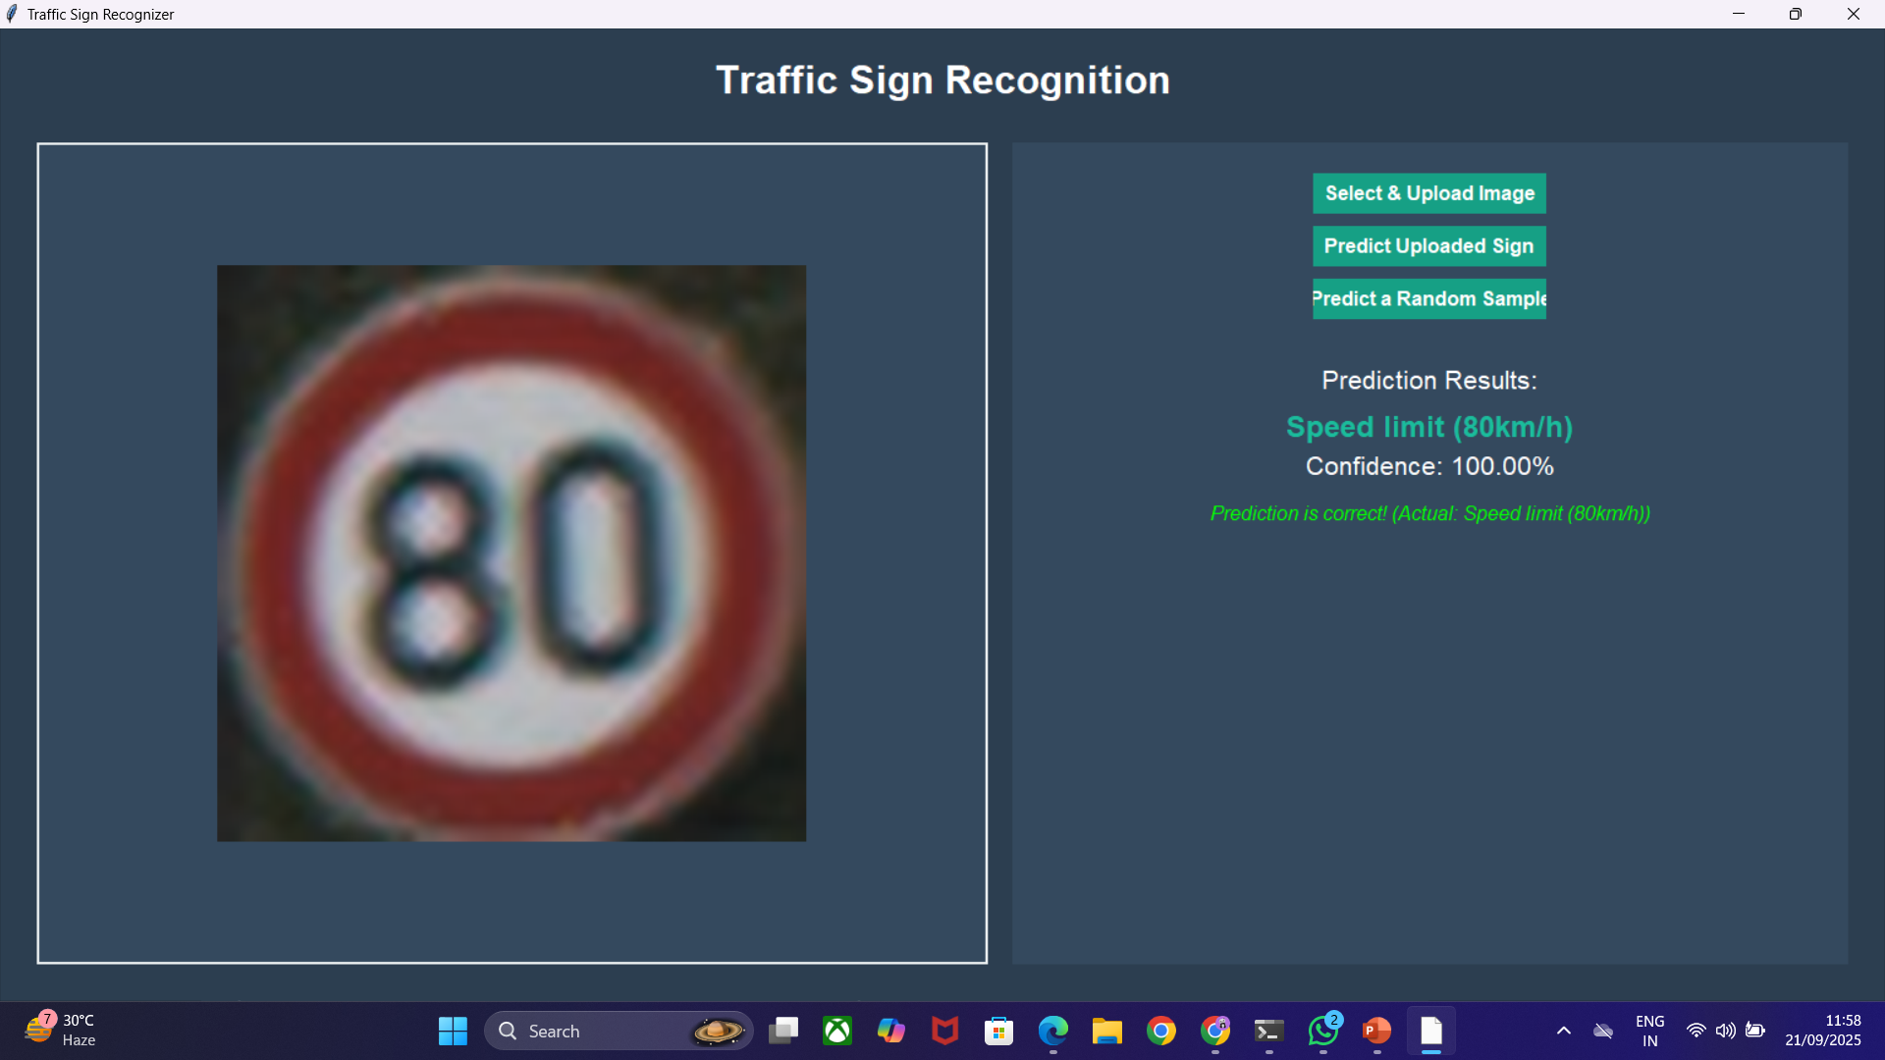

Slide 19
Conclusion
This project successfully developed a highly effective Traffic Sign Recognition (TSR) system using a Convolutional Neural Network (CNN). Advanced image preprocessing techniques like ROI cropping and CLAHE, along with data augmentation, made the model highly robust. The primary objective was exceeded, with the final model achieving an outstanding accuracy of 98.56% on unseen test data. This project’s success demonstrates the power of CNNs for enhancing Advanced Driver-Assistance Systems (ADAS) and autonomous vehicles. A functional GUI prototype was created to effectively demonstrate the model's practical application.

Slide 20
References
N G, Girish Kumar & Kishore, Ashish & Krishna, Aaditya. (2025). Real-time traffic sign recognition and autonomous vehicle control system using convolutional neural networks. Multimedia Tools and Applications. 1-36. 10.1007/s11042-025-20853-8.
Farag, Wael. (2019). Traffic signs classification by deep learning for advanced driving assistance systems. Intelligent Decision Technologies. 13. 1-10. 10.3233/IDT-180064.
Alghmgham, Danyah & Latif, Ghazanfar & Alghazo, Jaafar & Alzubaidi, Loay. (2019). Autonomous Traffic Sign (ATSR) Detection and Recognition using Deep CNN. Procedia Computer Science. 163. 266-274. 10.1016/j.procs.2019.12.108.

